Slide 1
CS-1002 Programming fundamentals
Instructor : Aqib Rehman
aqib.rehman@isb.nu.edu.pk
Fall 2023
FAST National University of Computer and Emerging Sciences, Islamabad

Slide 2
REVIEW OF LAST LECTURES

Slide 3
C++ Data Types
Simple
address
Structured
Integral
enum
Floating
pointer
reference
array
struct
union
class
char
short
int
long
bool
signed
unsigned
float
double
long double

Slide 4
Type Name | Bytes | Other Names | Range of Values
int | 4 | signed | –2,147,483,648 to 2,147,483,647
unsigned int | 4 | unsigned | 0 to 4,294,967,295
bool | 1 | none | false or true
char | 1 | none | –128 to 127
signed char | 1 | none | –128 to 127
unsigned char | 1 | none | 0 to 255
short | 2 | short int, signed short int | –32,768 to 32,767
unsigned short | 2 | unsigned short int | 0 to 65,535
long | 4/8 | long int, signed long int | –2,147,483,648 to 2,147,483,647
unsigned long | 4/8 | unsigned long int | 0 to 4,294,967,295
long long | 8 | none | –9,223,372,036,854,775,808 to 9,223,372,036,854,775,807
unsigned long long | 8 | none | 0 to 18,446,744,073,709,551,615
enum | varies | none
float | 4 | none | 3.4E +/- 38
double | 8 | none | 1.7E +/- 308
long double | 8/10/16 | none | same as double

Slide 5
Literals (fixed values)
Literals are fixed values used by a program.
Some examples of literals:
  22 3.14159
  false "Hi Kurt" 'c'
You can initialize a variable in the declaration by assigning it a value:
  int temp = 17;
  double PI = 3.14159;
  char alpha = ‘a';

Slide 6
const
You can add the const modifier to the declaration of a variable to tell the compiler that the value cannot be changed:
  const double factor = 5.0/9.0;
  const double offset = 32.0;
  celcius = (fahr - offset)*factor;

Slide 7
What if you try to change a const?
The compiler will complain if your code tries to modify a const variable:
  const int temp = 100;
  …
  temp = 21;
Error: l-value specifies const object

Slide 8
Why use const?
Const tells the compiler that a variable should never be changed.
You already know the variable should never be changed!
But - let the compiler save you from yourself (you might forget that it shouldn't be changed).

Slide 9
Basics of a Typical C++ Environment
Input/output
  cin
    Standard input stream
    Normally keyboard
  cout
    Standard output stream
    Normally computer screen

Slide 10
A Simple Program:
Printing a Line of Text
Comments
  Document programs
  Improve program readability
  Ignored by compiler
  Single-line comment
    Begin with //
  Multiple-line comment
    Everything between /* and */ is ignored.
Preprocessor directives
  Processed by preprocessor before compiling
  Begin with #
    # include
    # define

Slide 11
1 // code1.cpp
2 // A first program in C++.
3 #include <iostream>
4
5 // function main begins program execution
6 int main()
7 {
8 std::cout << "Welcome to C++!\n";
9
10 return 0; // indicate that program ended successfully
11
12 } // end function main
Single-line comments.
Function main returns an integer value.
Left brace { begins function body.
Preprocessor directive to include input/output stream header file <iostream>.
Function main appears exactly once in every C++ program..
Statements end with a semicolon ;.
Corresponding right brace } ends function body.
Stream insertion operator.
Name cout belongs to namespace std.
Keyword return is one of several means to exit function; value 0 indicates program terminated successfully.
Welcome to C++!

Slide 12
A Simple Program:
Printing a Line of Text
Standard output stream object
  std::cout
  “Connected” to screen
  <<
    Stream insertion operator
    Value to right (right operand) inserted into output stream
Namespace
  std:: specifies using name that belongs to “namespace” std
  std:: removed through use of using statements
  using namespace std;
Escape characters
  \
  Indicates “special” character output

Slide 13
TODAY’S LECTURE

Slide 14
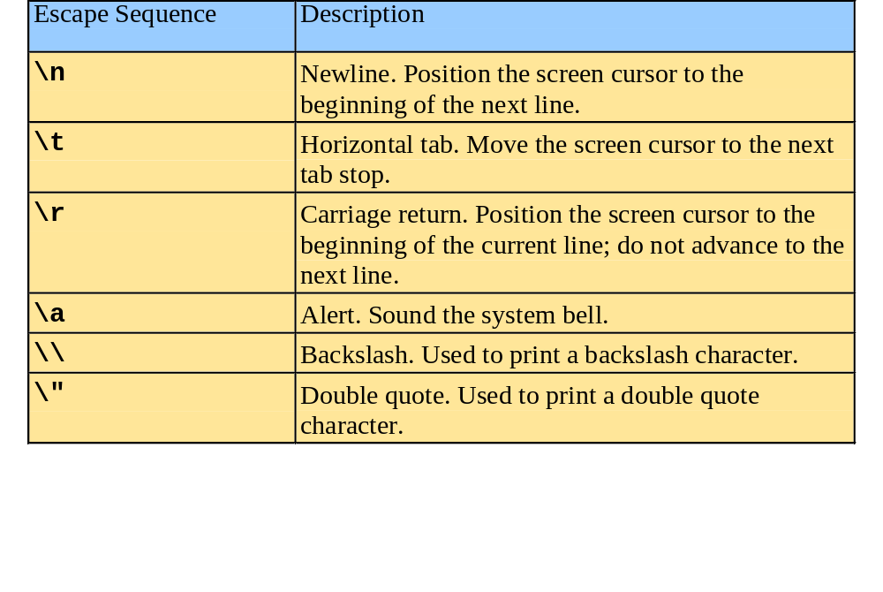
A Simple Program:
Printing a Line of Text

Slide 15
1 // code2.cpp
2 // Printing a line with multiple statements.
3 #include <iostream>
4
5 // function main begins program execution
6 int main()
7 {
8 std::cout << "Welcome ";
9 std::cout << "to C++!\n";
10
11 return 0; // indicate that program ended successfully
12
13 } // end function main
Multiple stream insertion statements produce one line of output.
Welcome to C++!

Slide 16
1 // code3.cpp
2 // Printing multiple lines with a single statement
3 #include <iostream>
4
5 // function main begins program execution
6 int main()
7 {
8 std::cout << "Welcome\nto\n\nC++!\n";
9
10 return 0; // indicate that program ended successfully
11
12 } // end function main
Using newline characters to print on multiple lines.

Slide 17
1 // code3.cpp
2 // Printing multiple lines with a single statement
3 #include <iostream>
4
5 // function main begins program execution
6 int main()
7 {
8 std::cout << "Welcome\nto\n\nC++!\n";
9
10 return 0; // indicate that program ended successfully
11
12 } // end function main
Using newline characters to print on multiple lines.
Welcome
to
C++!

Slide 18
Another Simple Program:
Adding Two Integers
Declare variables to store values
Input stream object
  >> (stream extraction operator)
    Used with std::cin
    Waits for user to input value, then press Enter (Return) key
    Stores value in variable to right of operator
      Converts value to variable data type
= (assignment operator)
  Assigns value to variable
  Binary operator (two operands)
  Example:
      sum = variable1 + variable2;

Slide 19
1 // code4.cpp
2 // Addition program.
3 #include <iostream>
4
5 // function main begins program execution
6 int main()
7 {
8 int integer1; // first number to be input by user
9 int integer2; // second number to be input by user
10 int sum; // variable in which sum will be stored
11
12 std::cout << "Enter first integer\n"; // prompt
13 std::cin >> integer1; // read an integer
14
15 std::cout << "Enter second integer\n"; // prompt
16 std::cin >> integer2; // read an integer
17
18 sum = integer1 + integer2; // assign result to sum
19
20 std::cout << "Sum is " << sum << std::endl; // print sum
21
22 return 0; // indicate that program ended successfully
23
24 } // end function main
Declare integer variables.
Use stream extraction operator with standard input stream to obtain user input.
Calculations can be performed in output statements: alternative for lines 18 and 20:
std::cout << "Sum is " << integer1 + integer2 << std::endl;
Stream manipulator std::endl outputs a newline, then “flushes output buffer.”
Concatenating, chaining or cascading stream insertion operations.

Slide 20
Enter first integer
45
Enter second integer
72
Sum is 117

Slide 21
Operators and Expressions

Slide 22
Expressions
C++ expressions are used to express computation.
Expressions include operations and the operands on which the operations are applied.
Operands can be variables, literals or constants.

Slide 23
Operators in C++
Arithmetic operators
Relational operators
Logical operators
Bitwise operators
Ternary, sizeof, typecasting, new and many more
Three things are important about operators
  Precedence
  Associativity
  Arity

Slide 24
Arithmetic
Arithmetic calculations
  +
    Addition
  -
    Subtraction
  *
    Multiplication
  /
    Division
    Integer division truncates remainder
      7 / 5 evaluates to 1
  %
    Modulus operator returns remainder
      7 % 5 evaluates to 2

Slide 25
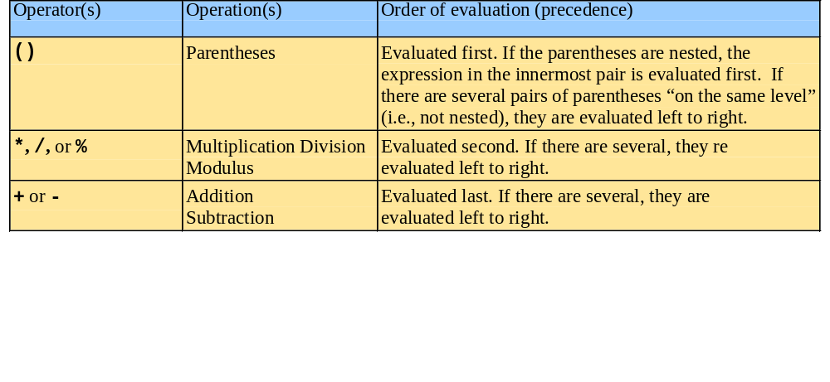
Arithmetic
Rules of operator precedence
  Operators in parentheses evaluated first
    Nested/embedded parentheses
      Operators in innermost pair first
  Multiplication, division, modulus applied next
    Operators applied from left to right
  Addition, subtraction applied last
    Operators applied from left to right

Slide 26
Confusing Equality (==) and Assignment (=) Operators
Common error
  Does not typically cause syntax errors
Aspects of problem
  Expressions that have a value can be used for decision
    Zero = false, nonzero = true
  Assignment statements produce a value (the value to be assigned)

Slide 27
Confusing Equality (==) and Assignment (=) Operators
Example
    if ( payCode == 4 )
    cout << "You get a bonus!" << endl;
  If paycode is 4, bonus given
If == was replaced with =
    if ( payCode = 4 )
    cout << "You get a bonus!" << endl;
  Paycode set to 4 (no matter what it was before)
  Statement is true (since 4 is non-zero)
  Bonus given in every case

Slide 28
Confusing Equality (==) and Assignment (=) Operators
Lvalues
  Expressions that can appear on left side of equation
  Can be changed (I.e., variables)
    x = 4;
Rvalues
  Only appear on right side of equation
  Constants, such as numbers (i.e. cannot write 4 = x;)
Lvalues can be used as rvalues, but not vice versa

Slide 29
Precedence
Precedence controls the order of evaluation of operators.
  A high precedence means an operator is evaluated (applied) before any lower precedence operators.
Operators that have the same precedence can happen in either order, but in C++ the one on the left is evaluated first.

Slide 30
Arity of operators
Unary Operator – one operand: a++, -a
Binary Operator – two operands: a – b, a+b
Ternary

Slide 31
Integer vs. floating point math
How does C++ know whether to use floating point or integer math operators?
If either operand is floating point, a floating point operation is done (the result is a floating point value).
If both operand are integer the result is an integer (even division).

Slide 32
Division
Floating point division
  when at least one of the operands is FP
Integer division
  when both operands are integer
7 / 2 →
3
7.0 / 2.0 →
3.5
7.0 / 2 →
3.5
7 / 2.0 →
3.5

Slide 33
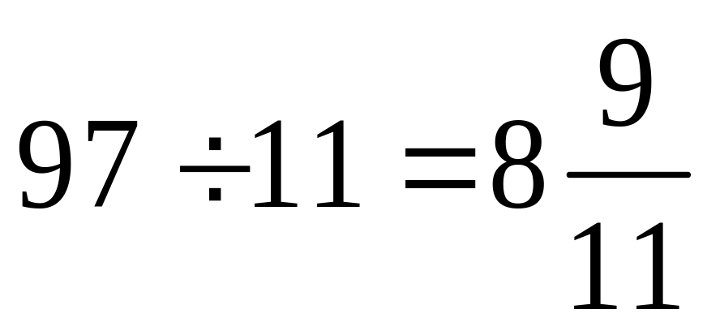
Quotient
Remainder
97 / 11 → 8 // quotient
97%11 → 9 // remainder
Modulus Operator

Slide 34
Expression
Value
3 + 6
9
3.4 - 6.1
-2.7
2 * 3
6
2 * 3.0
6.0
8 / 2
4
8.0 / 2.0
4.0
Mixed Mode Expressions
An expression that takes operands of different types.

Slide 35
Expression
Value
8 / 7
1
8 / 9
0
8 % 9
8
8 % 8
0
0 % 8
0

Slide 36
Expression
Value
8.0 % 5
Error
8 / 0
Error
8.0 / 0.0
Error
8 % 0
Error

Slide 37
Expression
Value
10 / 2 * 3
15
10 / 3 * 3
9
10 % 3 - 4 / 2
-1
2 + 3 * 4
14
(2 + 3) * 4
20
5 * 2 / 4 * 2
4
5.0 * 2.0 / 4.0 * 2.0
5.0
5.0 * 2.0 / (4.0 * 2.0)
1.25
10 - 10 / 3 * 3
1

Slide 38
Compound Expressions
  avgTemp = FREEZE_PT + BOILING_PT;
  avgTemp = avgTemp / 2.0;
✗
avgTemp = FREEZE_PT + BOILING_PT / 2.0;
avgTemp = (FREEZE_PT + BOILING_PT) / 2.0;

Slide 39
#include <iostream>
#include <iomanip>
int main () {
cout << setw(5);
cout <<123<< endl;
return 0;
}

Slide 40
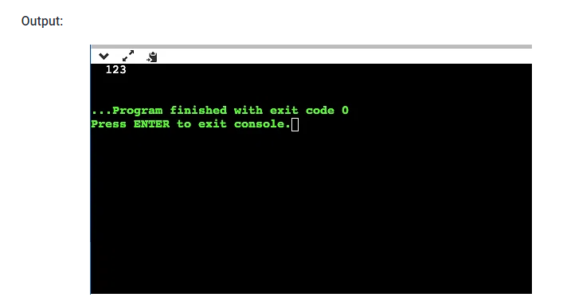

Slide 41
#include <iostream>
#include <iomanip>
using namespace std;
int main ()
{
int a,b;
a = 200;
b = 300;
cout << setw (5) << a << setw (5) << b << endl;
cout << setw (6) << a << setw (6) << b << endl;
cout << setw (7) << a << setw (7) << b << endl;
cout << setw (8) << a << setw (8) << b << endl;
return 0;
}

Slide 42
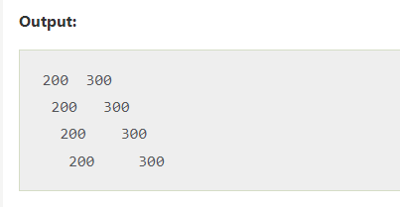

Slide 43
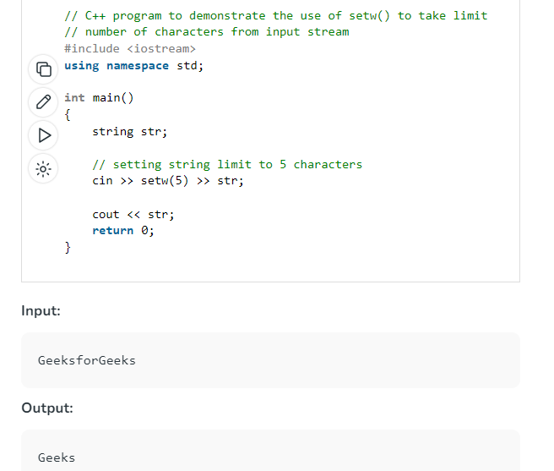

Slide 44
#include <iostream> // std::cout, std::endl
#include <iomanip> // std::setfill, std::setw
using namespace std;
int main () {
cout << setfill ('x') << setw (10);
cout << 24 << endl;
return 0;
}

Slide 45
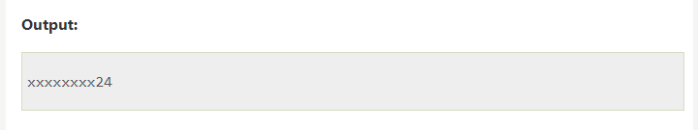

Slide 46
#include <iostream>
#include <iomanip>
using namespace std;
int main ( void)
{
int a,b;
a = 200;
b = 300;
cout << setfill ( '*' );
cout << setw (5) << a << setw (5) << b << endl;
cout << setw (6) << a << setw (6) << b << endl;
cout << setw (7) << a << setw (7) << b << endl;
cout << setw (8) << a << setw (8) << b << endl;
return 0;
}

Slide 47
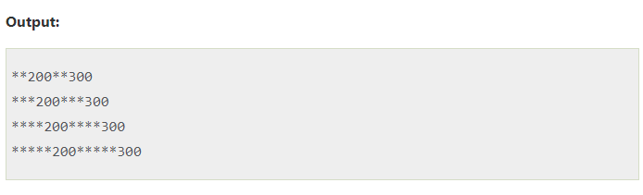

Slide 48
#include <iostream>
#include <iomanip>
using namespace std;
int main ( void)
{
int a,b;
a = 200;
b = 300;
cout << setfill ( '*' );
cout << setw (5) << a << setw (5) << b << endl;
cout << setw (6) << a << setw (6) << b << endl;
cout << setfill ( '#' );
cout << setw (7) << a << setw (7) << b << endl;
cout << setw (8) << a << setw (8) << b << endl;
return 0;
}

Slide 49
#include <iostream>
#include <iomanip>
using namespace std;
int main ( void)
{
int a,b;
a = 200;
b = 300;
cout << setfill ( '*' ) << setw (5) << a << setw (5) << b << endl;
cout << setw (6) << a << setw (6) << b << endl;
cout << setfill ( '#' );
cout << setw (7) << a << setw (7) << b << endl;
cout << setw (8) << a << setw (8) << b << endl;
return 0;
}

Slide 50
**200**300
***200***300
####200####300
#####200#####300

Slide 51
Cout<<setfill(‘ ‘);

Slide 52
THANK YOU
QUESTIONS

